Slide 1
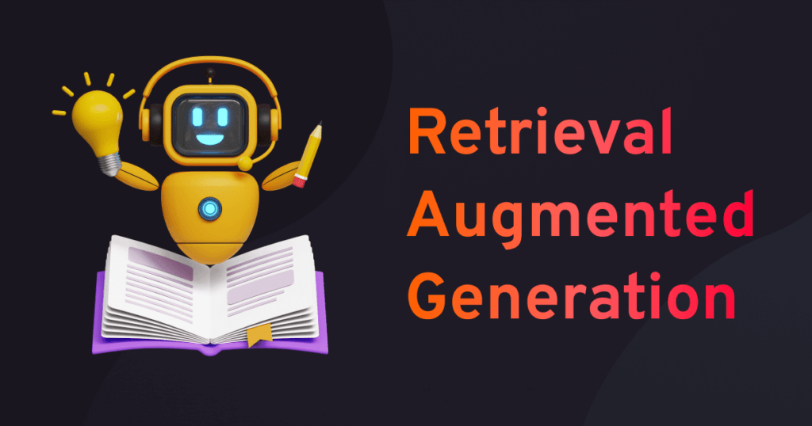
05.06.2025
Jonas Wolber

Slide 2
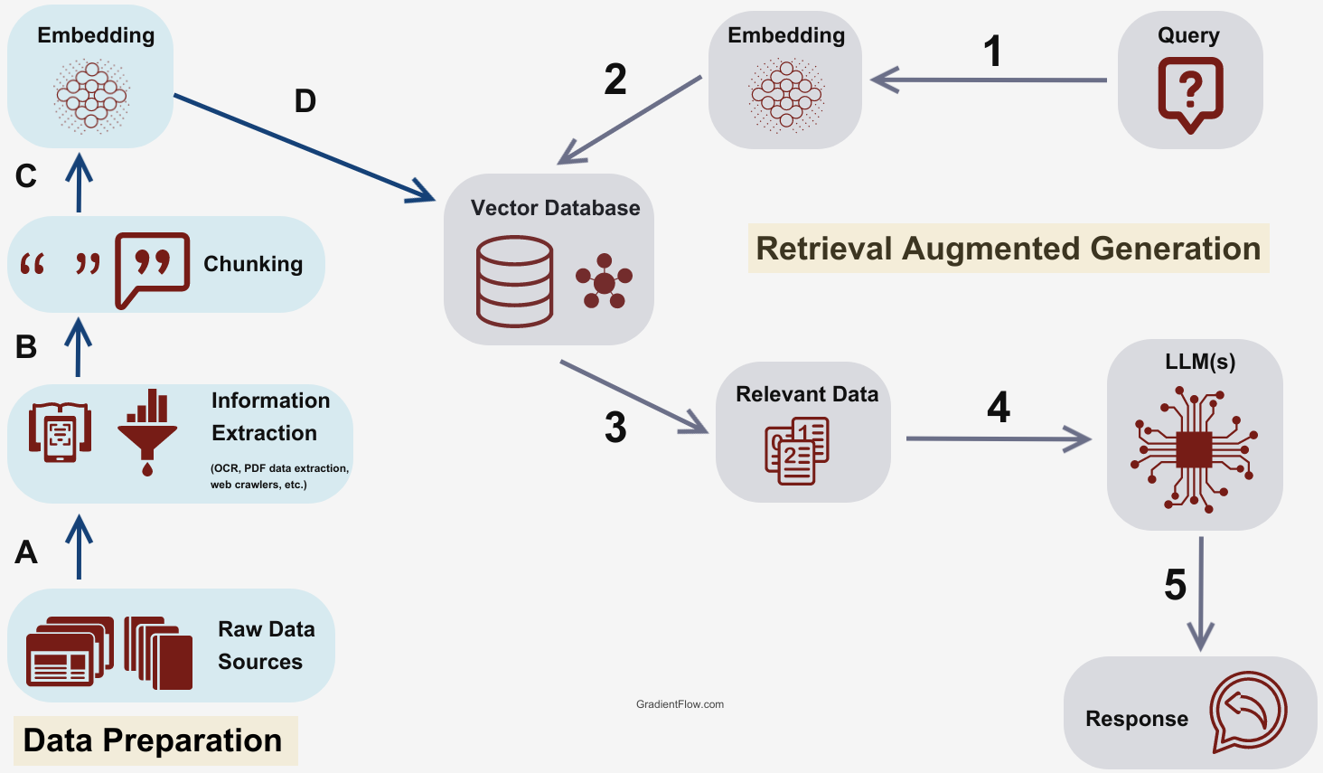
What is Retrieval Augmented Generation (RAG)?
Image taken from: fusionchat.ai/news/10-ways-rag-enhances-ai-systems

Slide 3
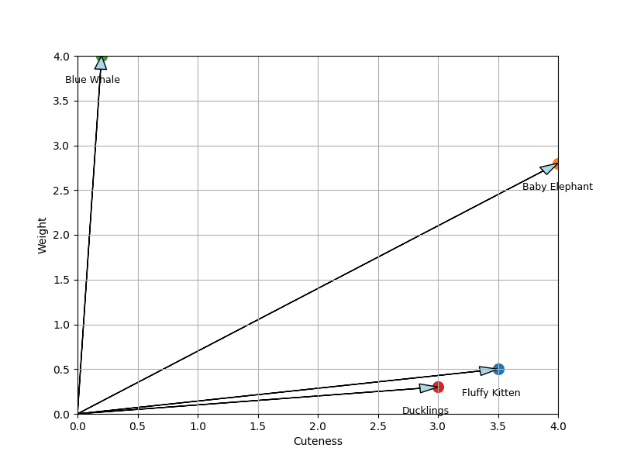
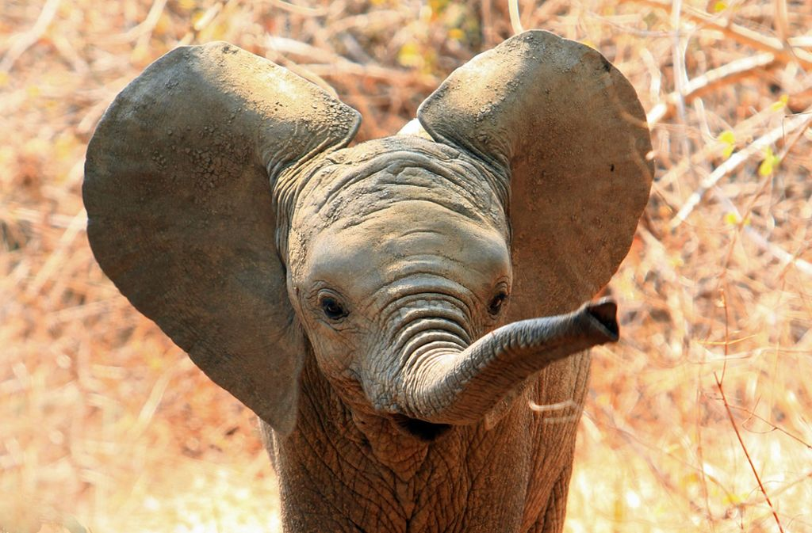
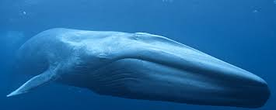
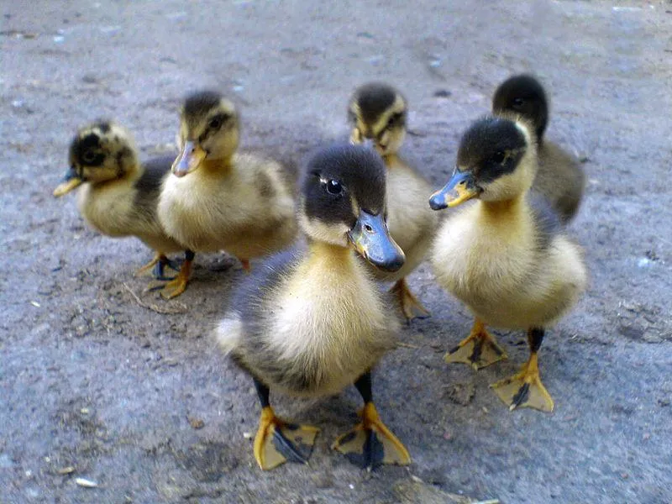

Word embeddings and vector space
Text
"Center for Computational Life Sciences"
Tokenization
Tokens
“Cen“, “ter“, “for“, “Compu“, “tational“, “Life“, “Scien“, “ces“
Embedding
Embeddings
[0.016539961, -0.025933826, 0.048515484, 0.03760145, -0.04732014, -0.002327353, …]

Slide 4





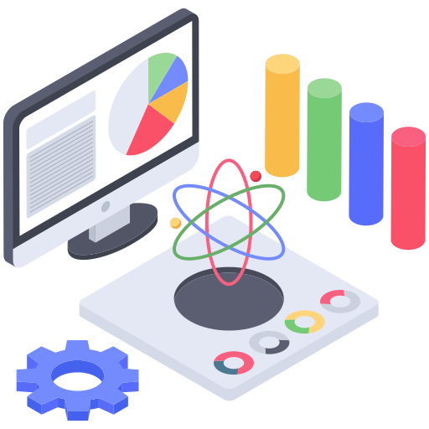
Applications of RAG
Question Answering
Document Summarization
Coding Assistants
Enterprise Knowledge Management
Patient Diagnostics
Scientific Research
Icons made by Freepik, Juicyfish, Dewi Sari, Vectorsmarket from www.flaticon.com

Slide 5
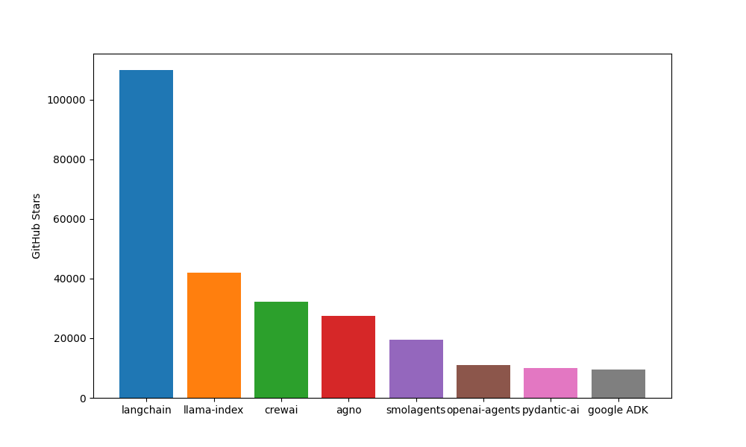

Frameworks for LLMs, RAG and Agentic AI
Beginner-friendly
Lightweight
Fast
Open-source
Flexible

Slide 6
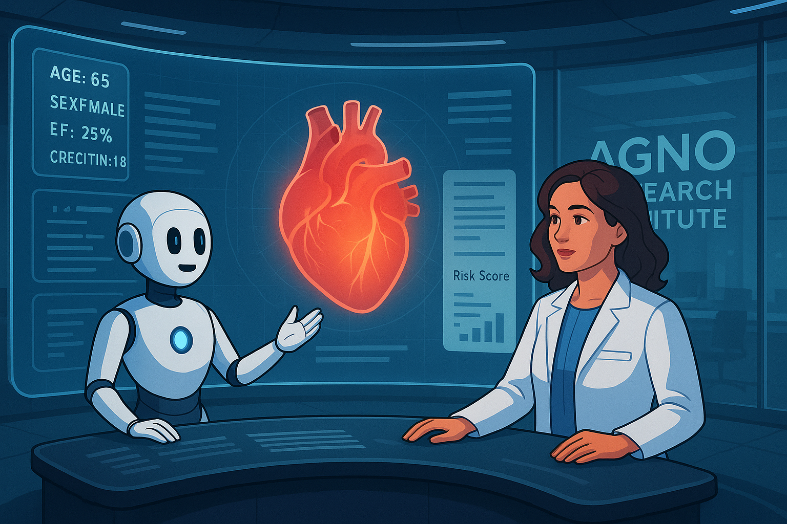
RAG topics
1. Embeddings
2. Vector Databases
3. Chunking strategies
4. Retrieval
5. Working with different types of data

Slide 7
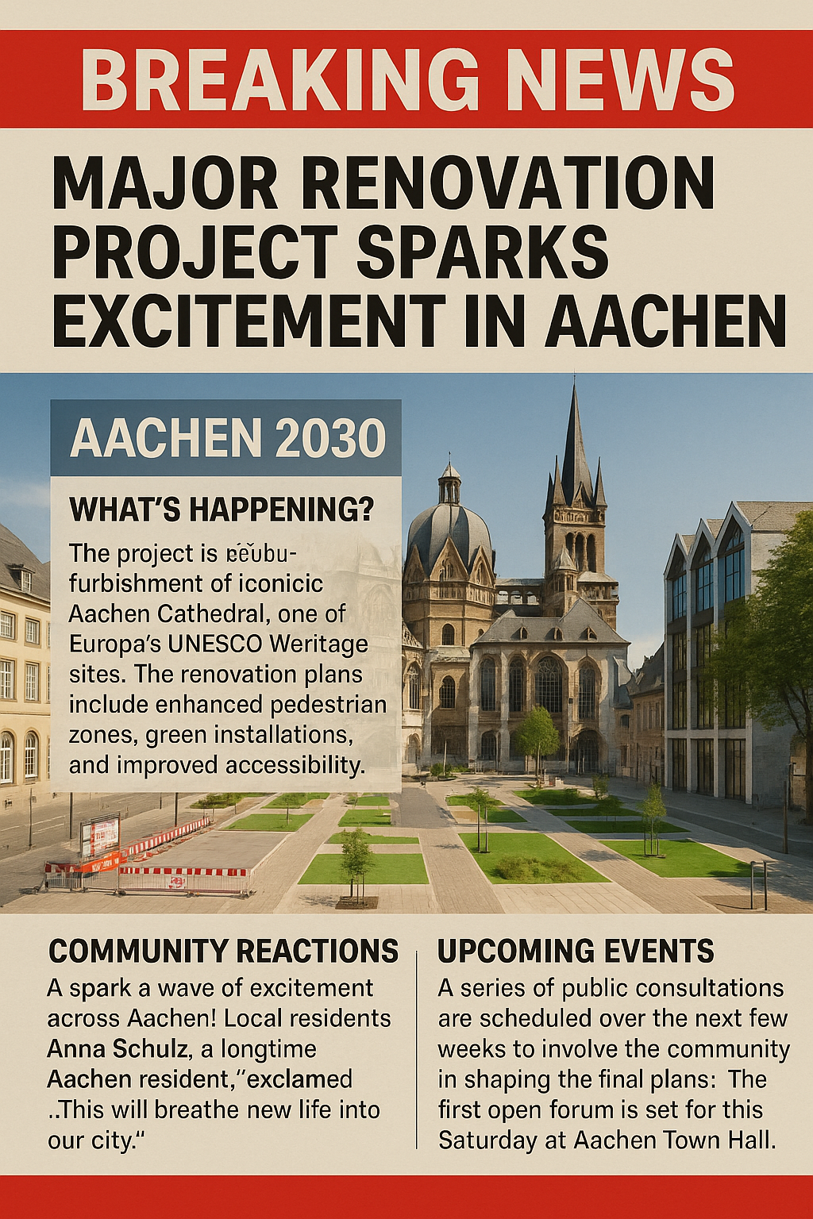
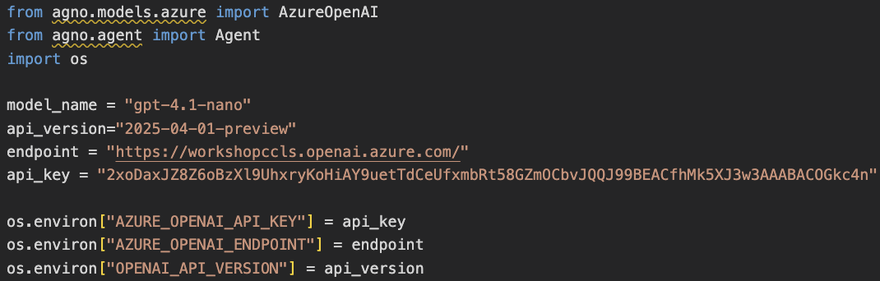
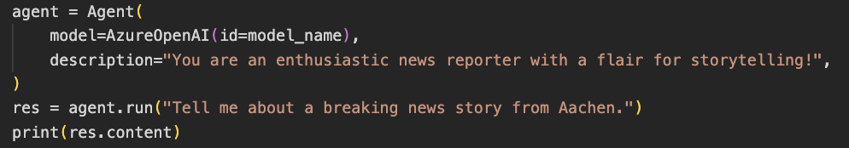
Setting up the Python environment
1. Setting up the environment
2. Install dependencies
3. Set up Azure OpenAI
4. Test

